Slide 2
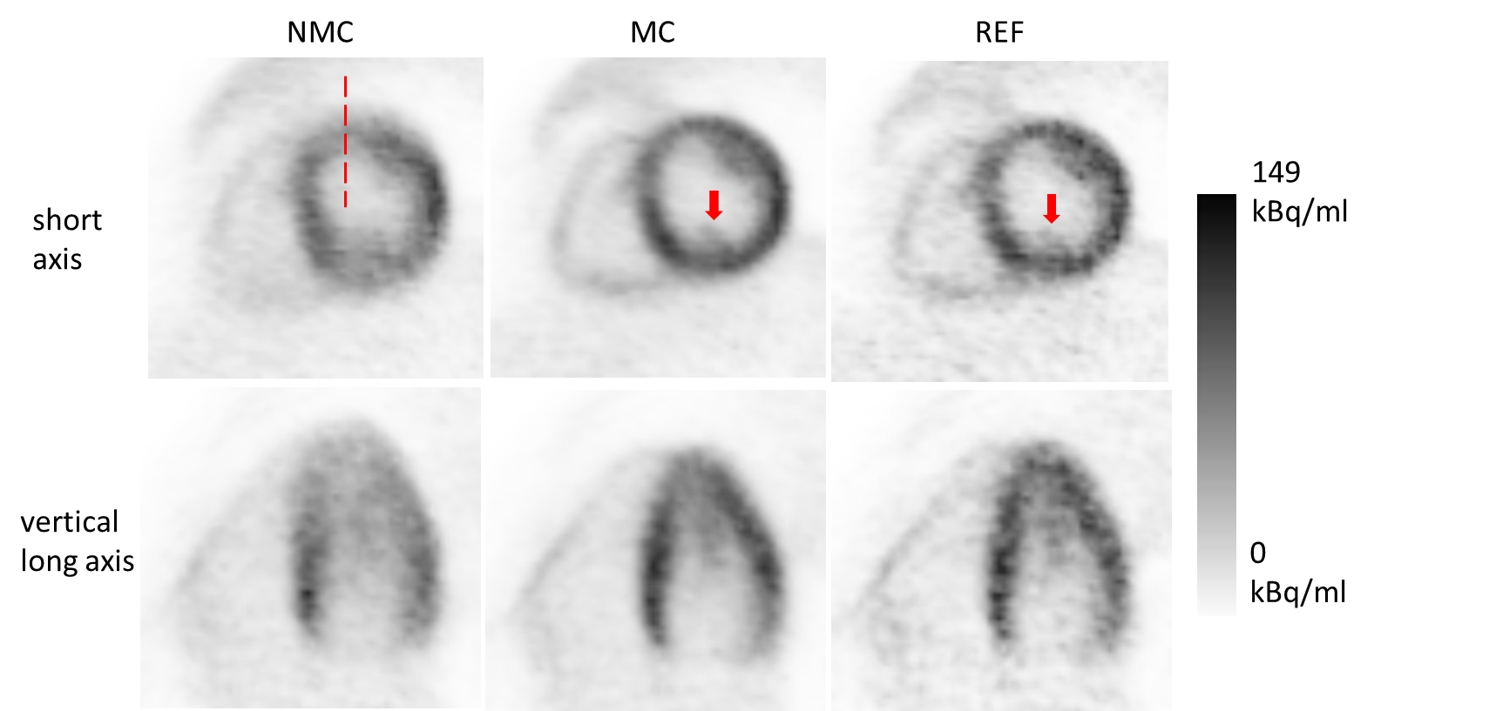
Figure 1 Left: non-corrected PET image. Middle: corrected image. Right: reference scan.

Slide 3
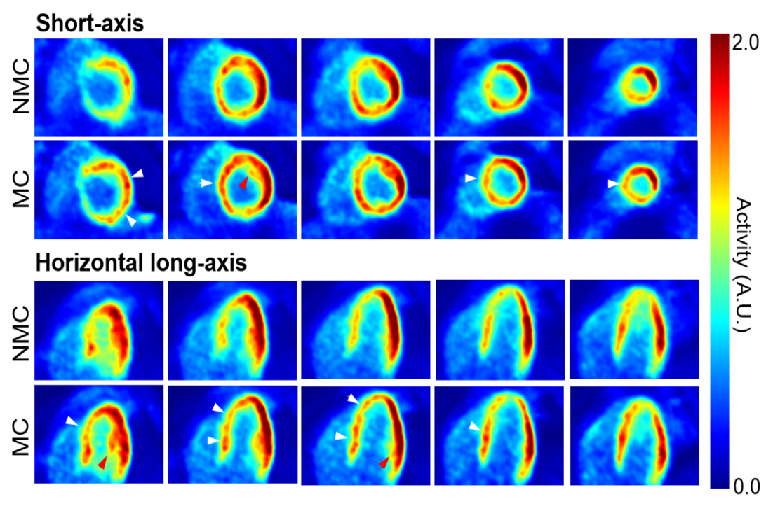
Figure 2 First, third rows: non-corrected PET image. Second, fourth rows: corrected image.

Slide 4
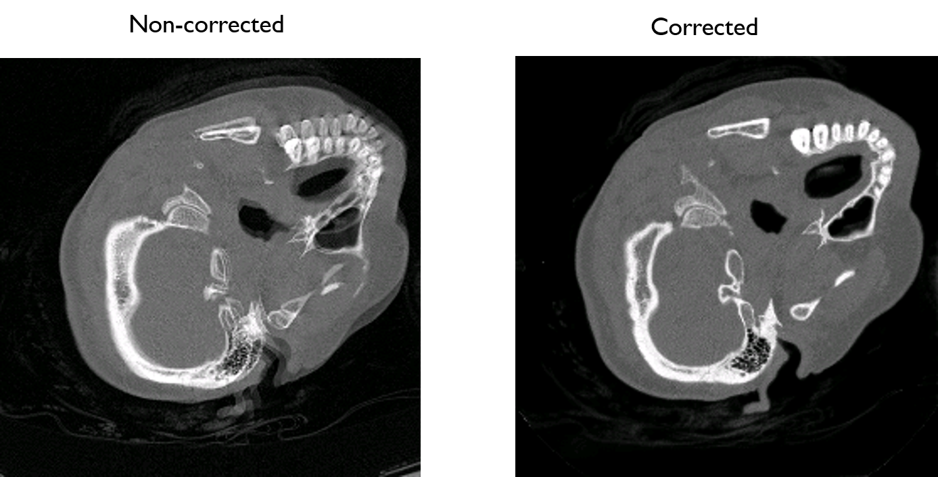
Figure 3a Left: non-corrected PET image. Middle: corrected image.

Slide 5
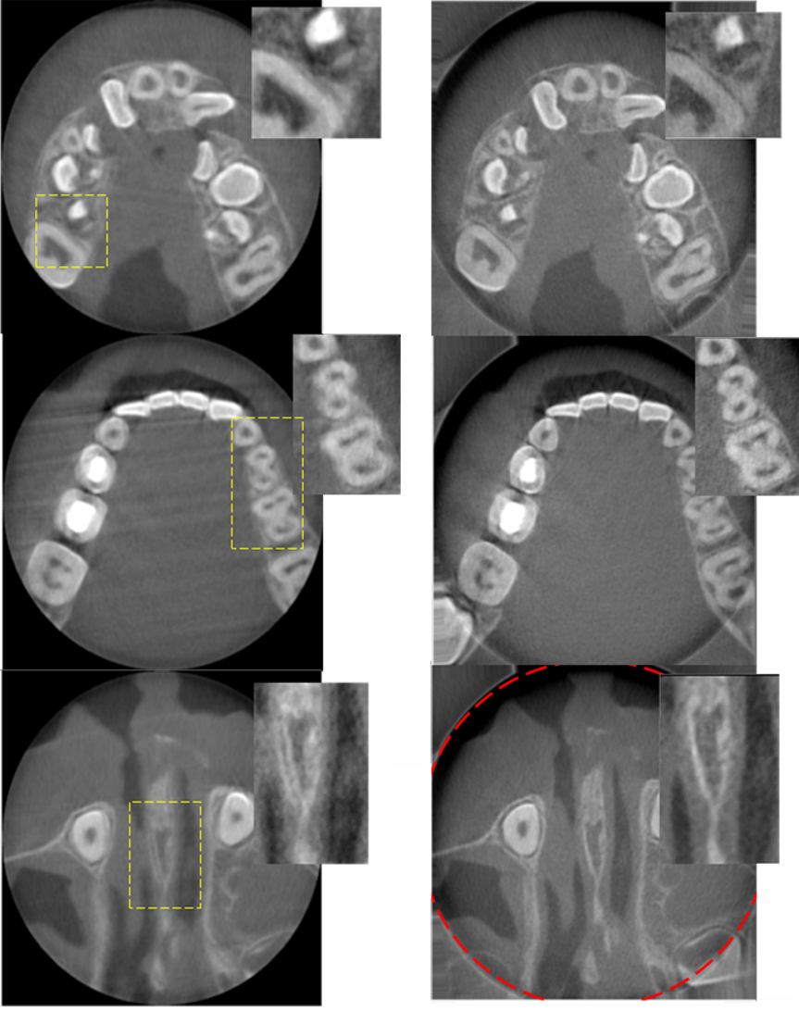
Figure 3b Left: non-corrected PET image. Middle: corrected image.

Slide 6
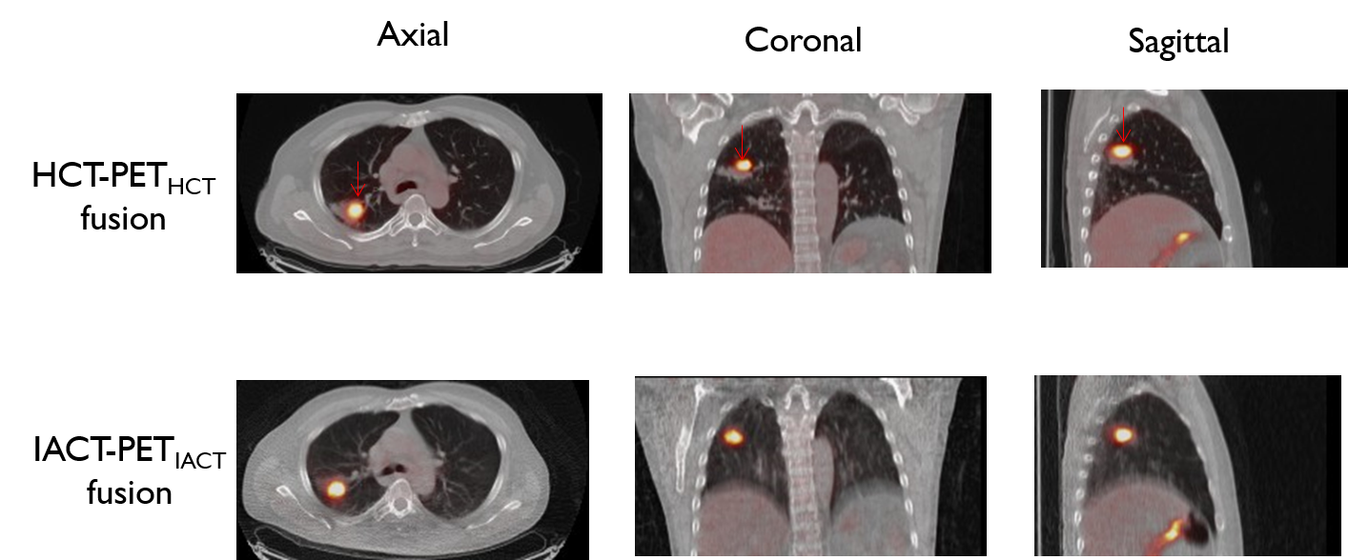
Figure 4 Top: Original PET/CT fusion. Bottom: after matching with proposed method.

Slide 7
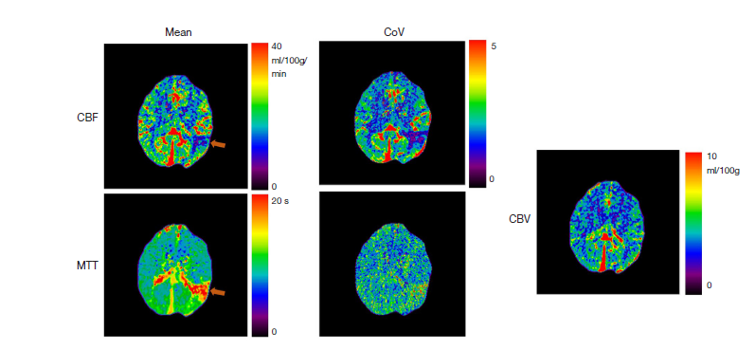
Figure Mean and Coefficient-of-variance maps inferred from a patient scan using the proposed method, in which a lesion due to the left middle cerebral infarct was indicated by the arrow. The average CBF value in the lesion was over 40% lower than the normal tissue and the average MTT value in the lesion was over 96% higher than the normal tissue.

Slide 8
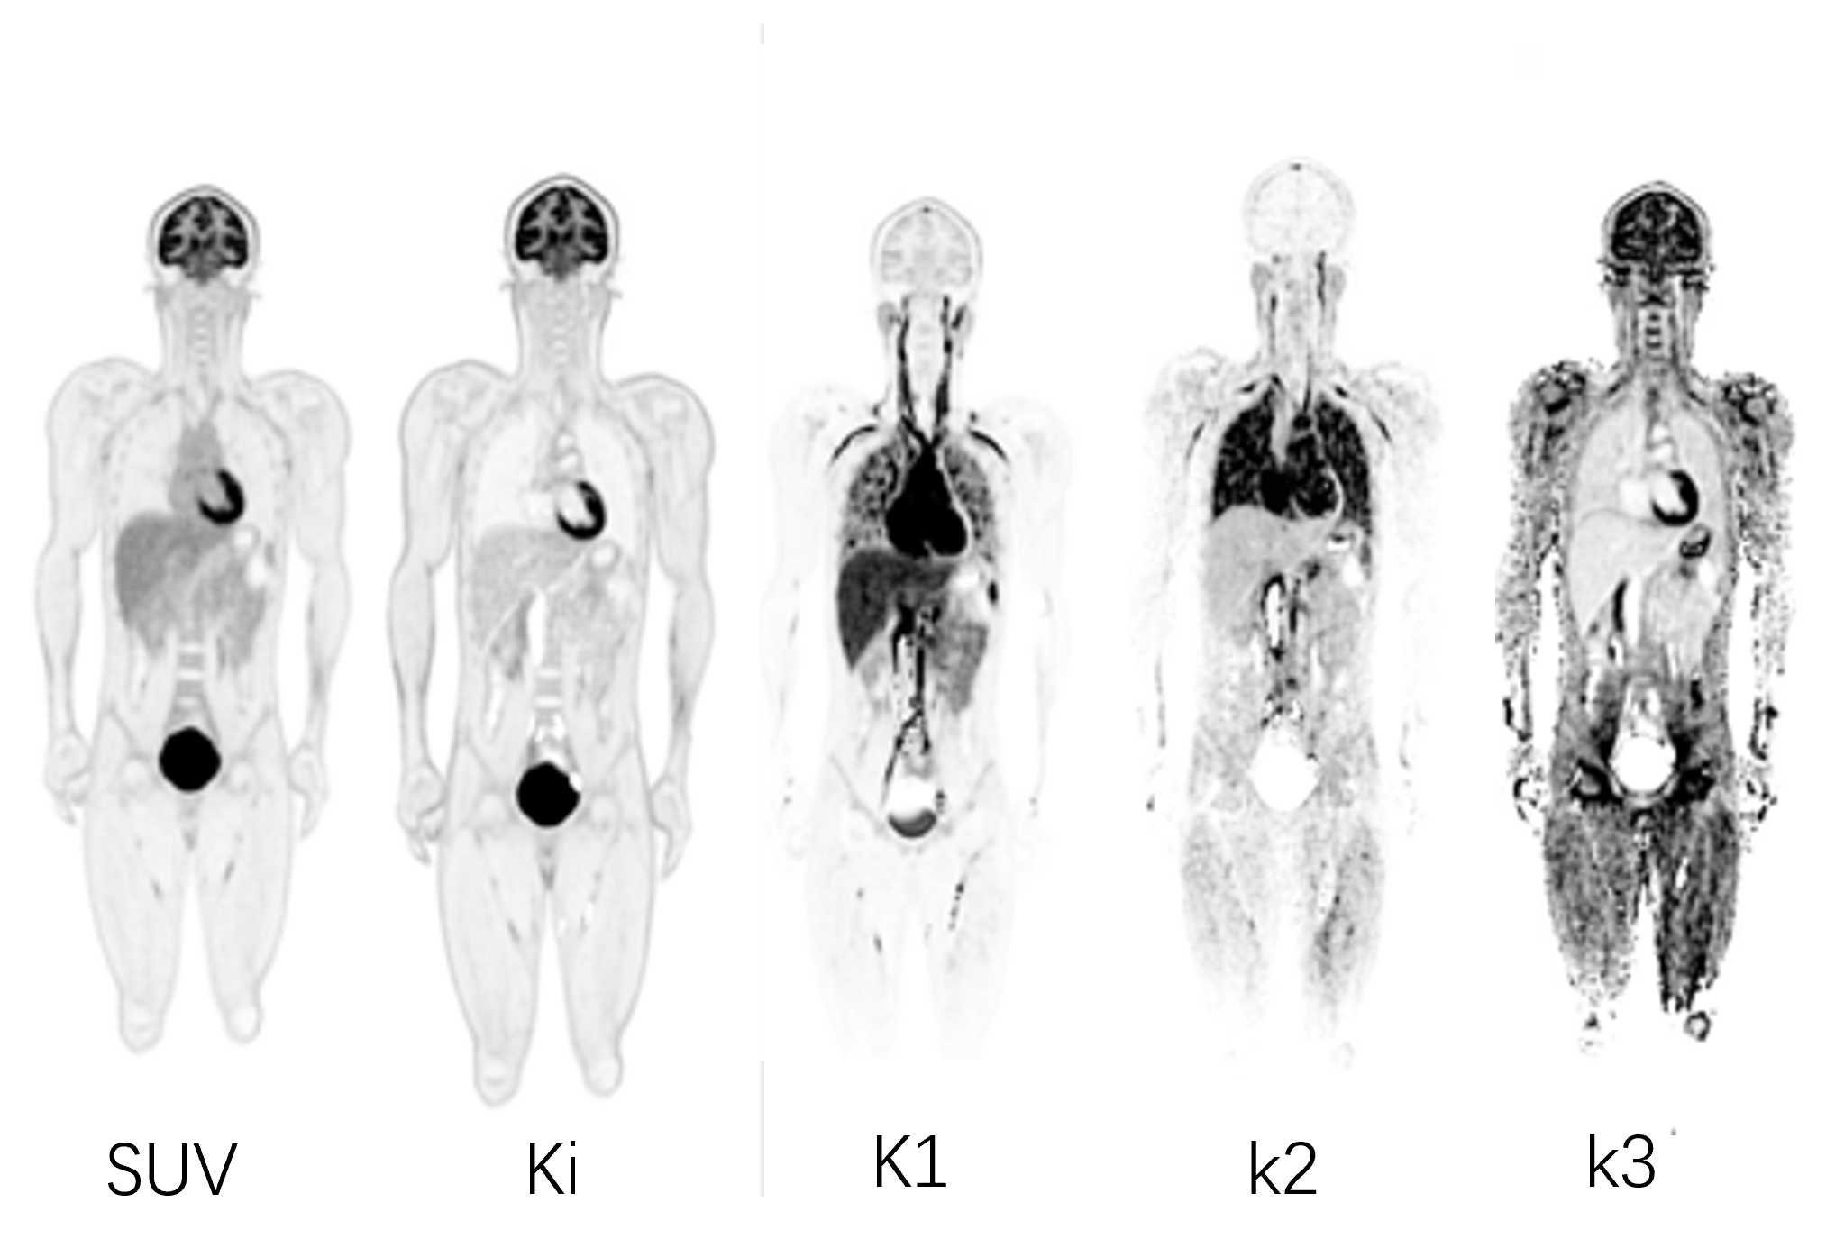
Figure Total-body parametric images from a 18F-FDG scan.

